Slide 1
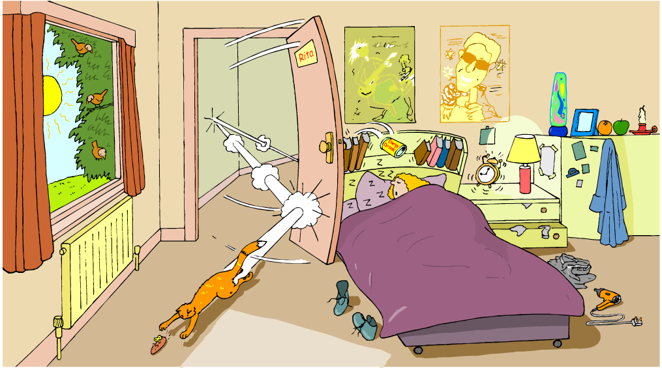
Identify all the forms of energy you see in the picture below.

Slide 2
Learning Objectives
I can describe the 6 forms of energy.
I can give example of the 6 forms of energy.

Slide 3
In our previous lesson, we learned that there are two types of energy: Potential Energy & Kinetic Energy
There are also many forms of energy. This lesson will provide an overview of some forms of energy.

Slide 4
Forms of Energy
Thermal energy (Heat)
Mechanical energy (includes sound energy)
Electromagnetic (light/radiant) energy
Electrical energy
Chemical energy
Nuclear energy

Slide 5
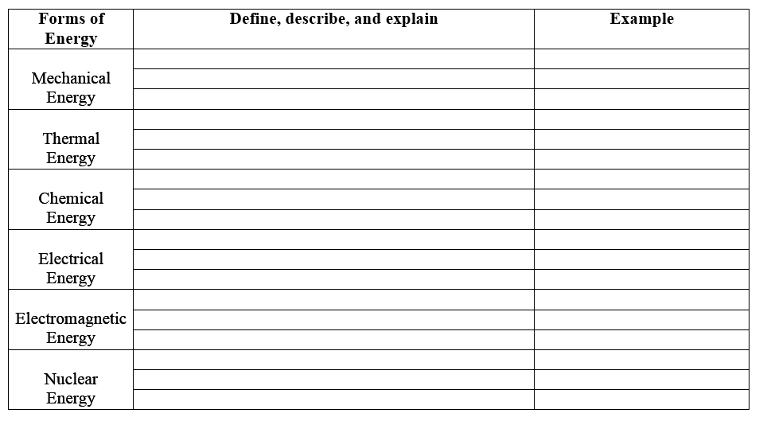
Use Your Graphic Organizer to Record Important Information

Slide 6
Thermal Energy (Heat)
The total potential and kinetic energy related to all the motion of the particles in an object.
Energy that is created in the movement of particles (atoms) that produces heat.
Thermal (Heat) energy increases as temperature increases
The faster the particles (atoms) move, the greater the kinetic energy and the greater the object’s thermal energy. The opposite is also true.
Thermal energy also depends on the number of particles. If there are more particles, there is more thermal energy.

Slide 7
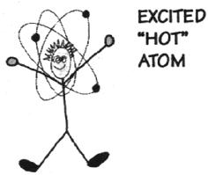
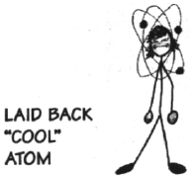
Thermal (Heat) Energy
A hot object is one whose atoms and molecules are excited and show rapid movement.
(More heat energy)
A cooler object's molecules and atoms will show less movement. (Less heat energy)

Slide 8
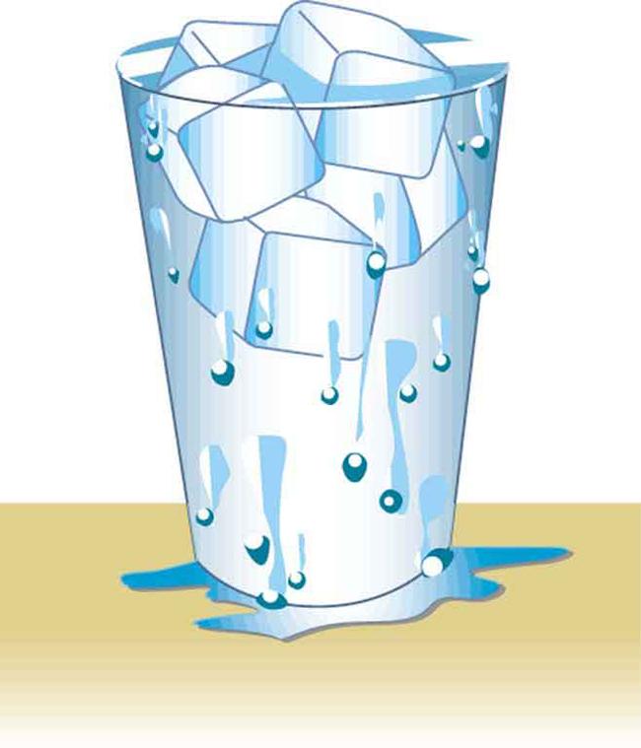
Which has more thermal energy? Why?
Hot Chocolate
Ice Water

Slide 9

Mechanical Energy
Energy of motion
The total energy of motion and
position of an object
(potential energy + kinetic energy)
Law of Conservation of Energy
  KE + PE (beginning) = KE + PE (end)
Mechanical energy can be all
potential energy, all kinetic
energy, or some of each.

Slide 10

Mechanical Energy
The mechanical energy of an
object stays the same, but the
potential and kinetic energy of
an object can increase or decrease.
Think of juggling. The kinetic energy decreases until all of the ball’s kinetic energy turns into potential energy, and it stops moving upward.
As the ball falls back down again, its potential energy starts changing back into kinetic energy.

Slide 11
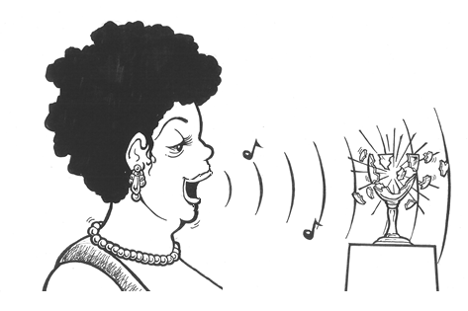
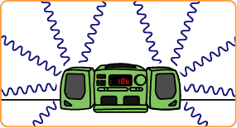
Sound Energy a form of Mechanical
Sound energy is caused by an object’s vibrations
A vibrating object transmits energy through the air around it in waves (longitudinal waves)

Slide 12
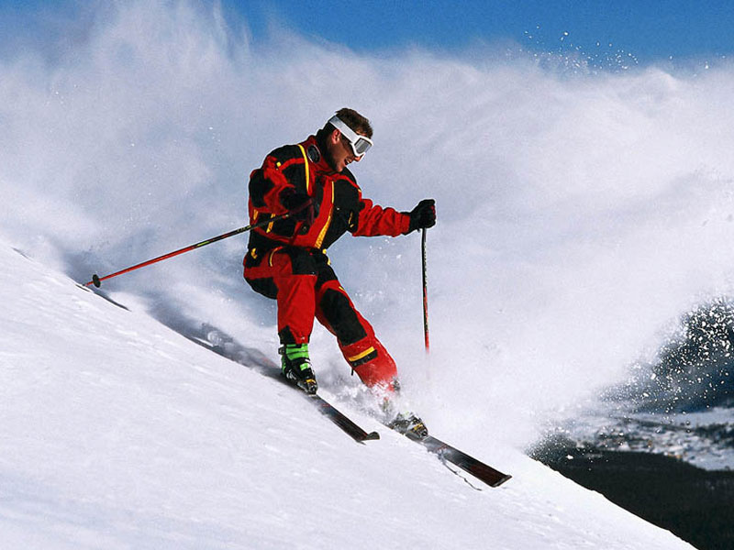
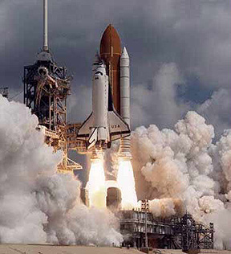
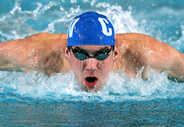
Examples of Mechanical Energy

Slide 13
Electromagnetic (Light/Radiant) Energy
Energy created by vibrating particles that create waves that travel through space and time. [These waves are called electromagnetic waves.]
Electromagnetic energy can be absorbed, transmitted, or reflected.
Includes energy from gamma rays, x-rays, ultraviolet rays, visible light, infrared rays, microwave and radio bands. (Electromagnetic spectrum)

Slide 14
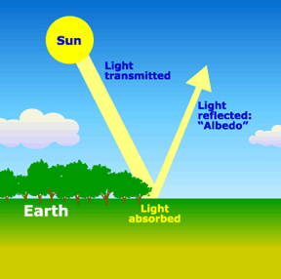
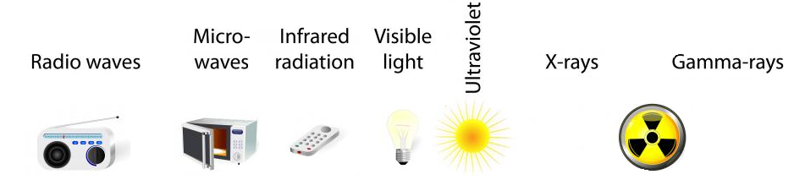
Examples of Electromagnetic Energy

Slide 15
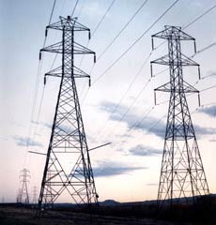
Electrical Energy
Energy that is associated with electric charges.
Energy that is carried by an electrical current (the movement of electrons, the negatively charged particles of atoms.)
The electrical energy used in your home can be thought of as potential energy that is used when you plug in an electrical appliance and use it.

Slide 16
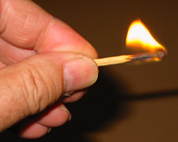
Chemical Energy
Energy stored in chemical bonds
When chemical bonds are broken, new chemicals are formed and some of it is released energy
Examples: Food, Battery, Burning candle or Wood, Fireworks, Fossil Fuels, Gasoline

Slide 17
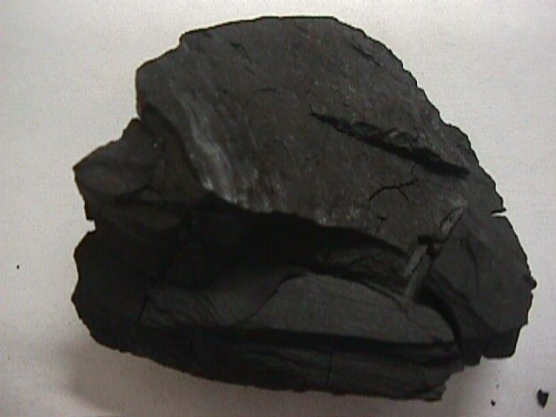
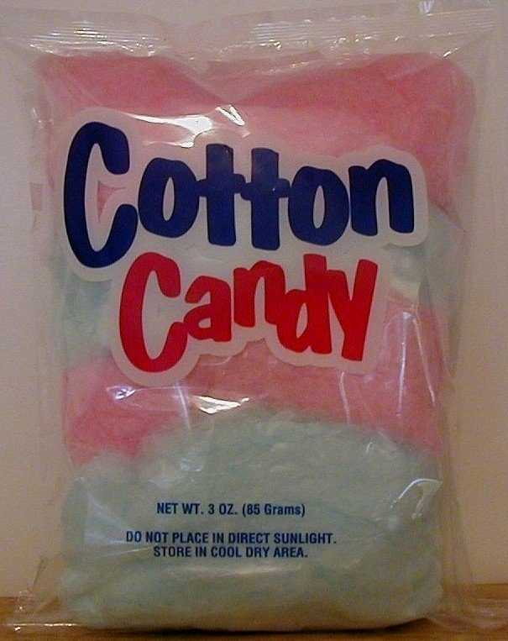
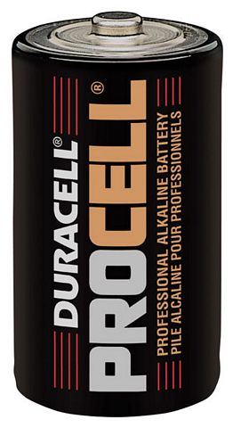
Examples of Chemical Energy

Slide 18
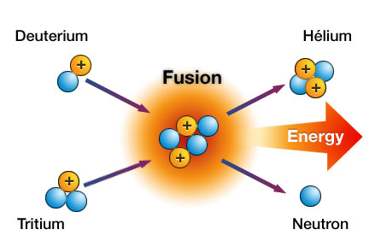
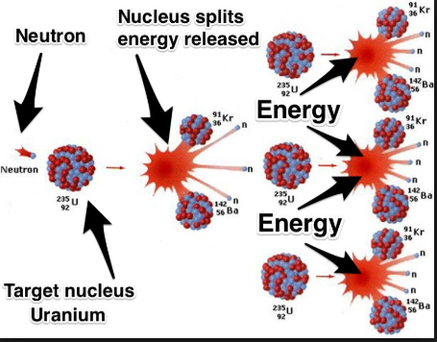
Nuclear Energy
The energy stored in atomic nuclei
Energy released from splitting atoms (fission) or process of making a single heavy nucleus from 2 lighter ones (Fusion)
Examples: Nuclear fusion and nuclear fission.

Slide 19
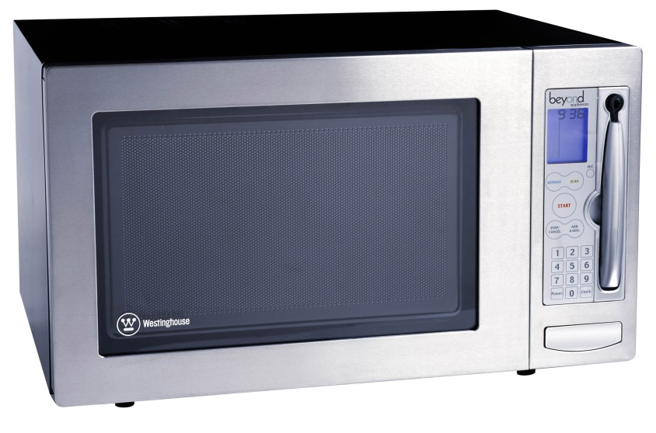
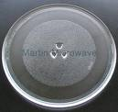
What type of energy cooks food in a microwave oven?
ELECTROMAGNETIC ENERGY
What type of energy is the spinning plate inside of a microwave oven?
MECHANICAL ENERGY

Slide 20
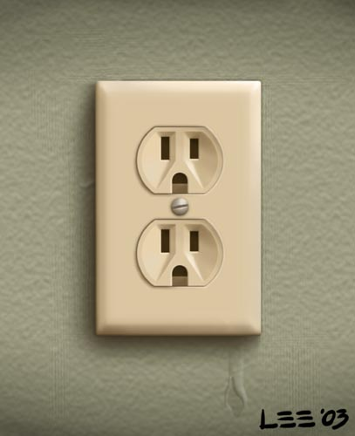
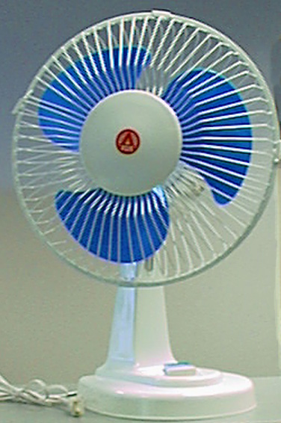
Electrical energy is transported to your house through power lines.
When you plug an electric fan to a power outlet, electrical energy is transformed into what type of energy?
MECHANICAL ENERGY

Slide 21

What type of energy is shown below?
Chemical Energy

Slide 22

What types of energy are shown below?
Chemical, Mechanical and
Radiant Energy

Slide 23
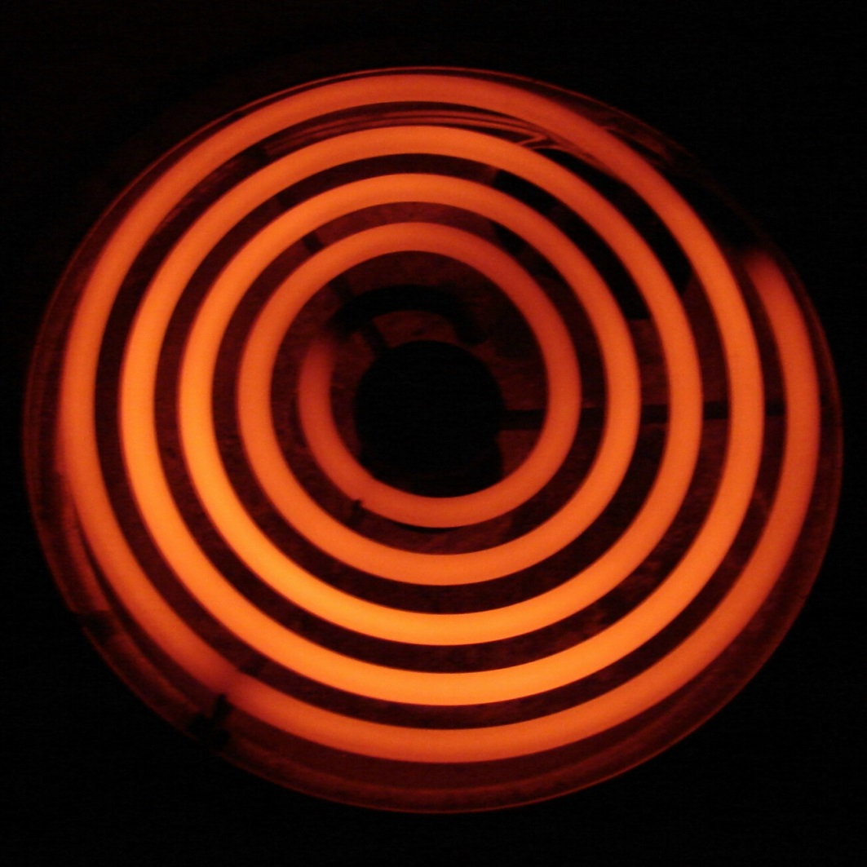
What type of energy is shown below?
Thermal Energy

Slide 24
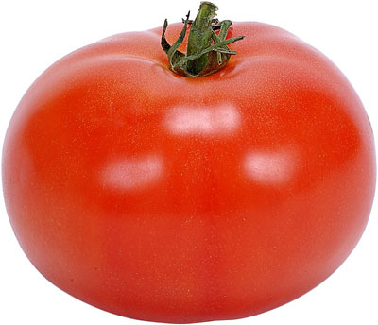
What type of energy is shown below?
Chemical Energy (yummy)

Slide 25
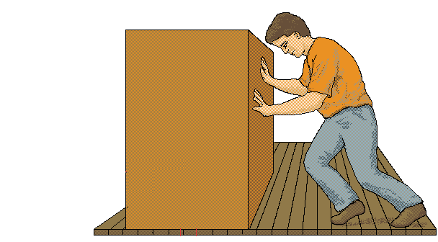
What types of energy are shown below?
Mechanical and Thermal Energy
(Friction causes thermal energy)

